Slide 1
DevOps Pipelines

Slide 2
Project-01:
Name of the Project: DevOps Project
Target Module: Set out CI/CD pipeline to release apps along with infrastructure automation
Services to be used: GITHUB, MAVEN, APACHE TOMCAT, JENKINS, PACKER, TERRAFORM, AWS EC2

Slide 3



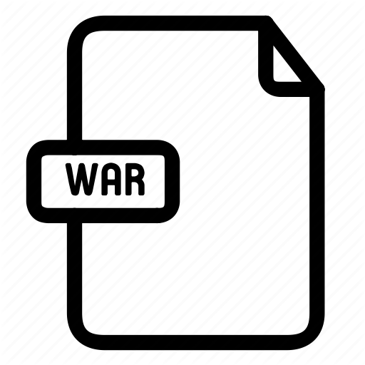
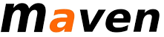

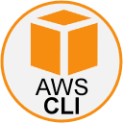
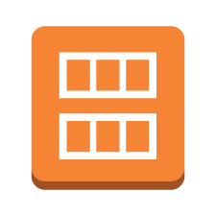
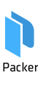


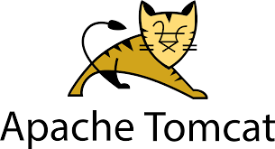

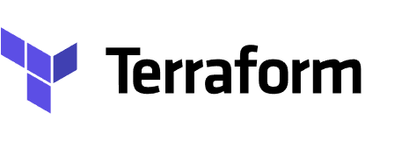
DevOps Project
Developer
dev/qa/prod env
GITHUB
git pull
git add
commit & push
mvn-build-clean
mvn-build-war
warUploadtos3
warUploadtos3
warUploadtos3
warDownloadtoS3
packer-build-AMI
packer-AMI
Ubuntu-AMI
terraform-pr
terraform-pr
packer-AMI

Slide 4
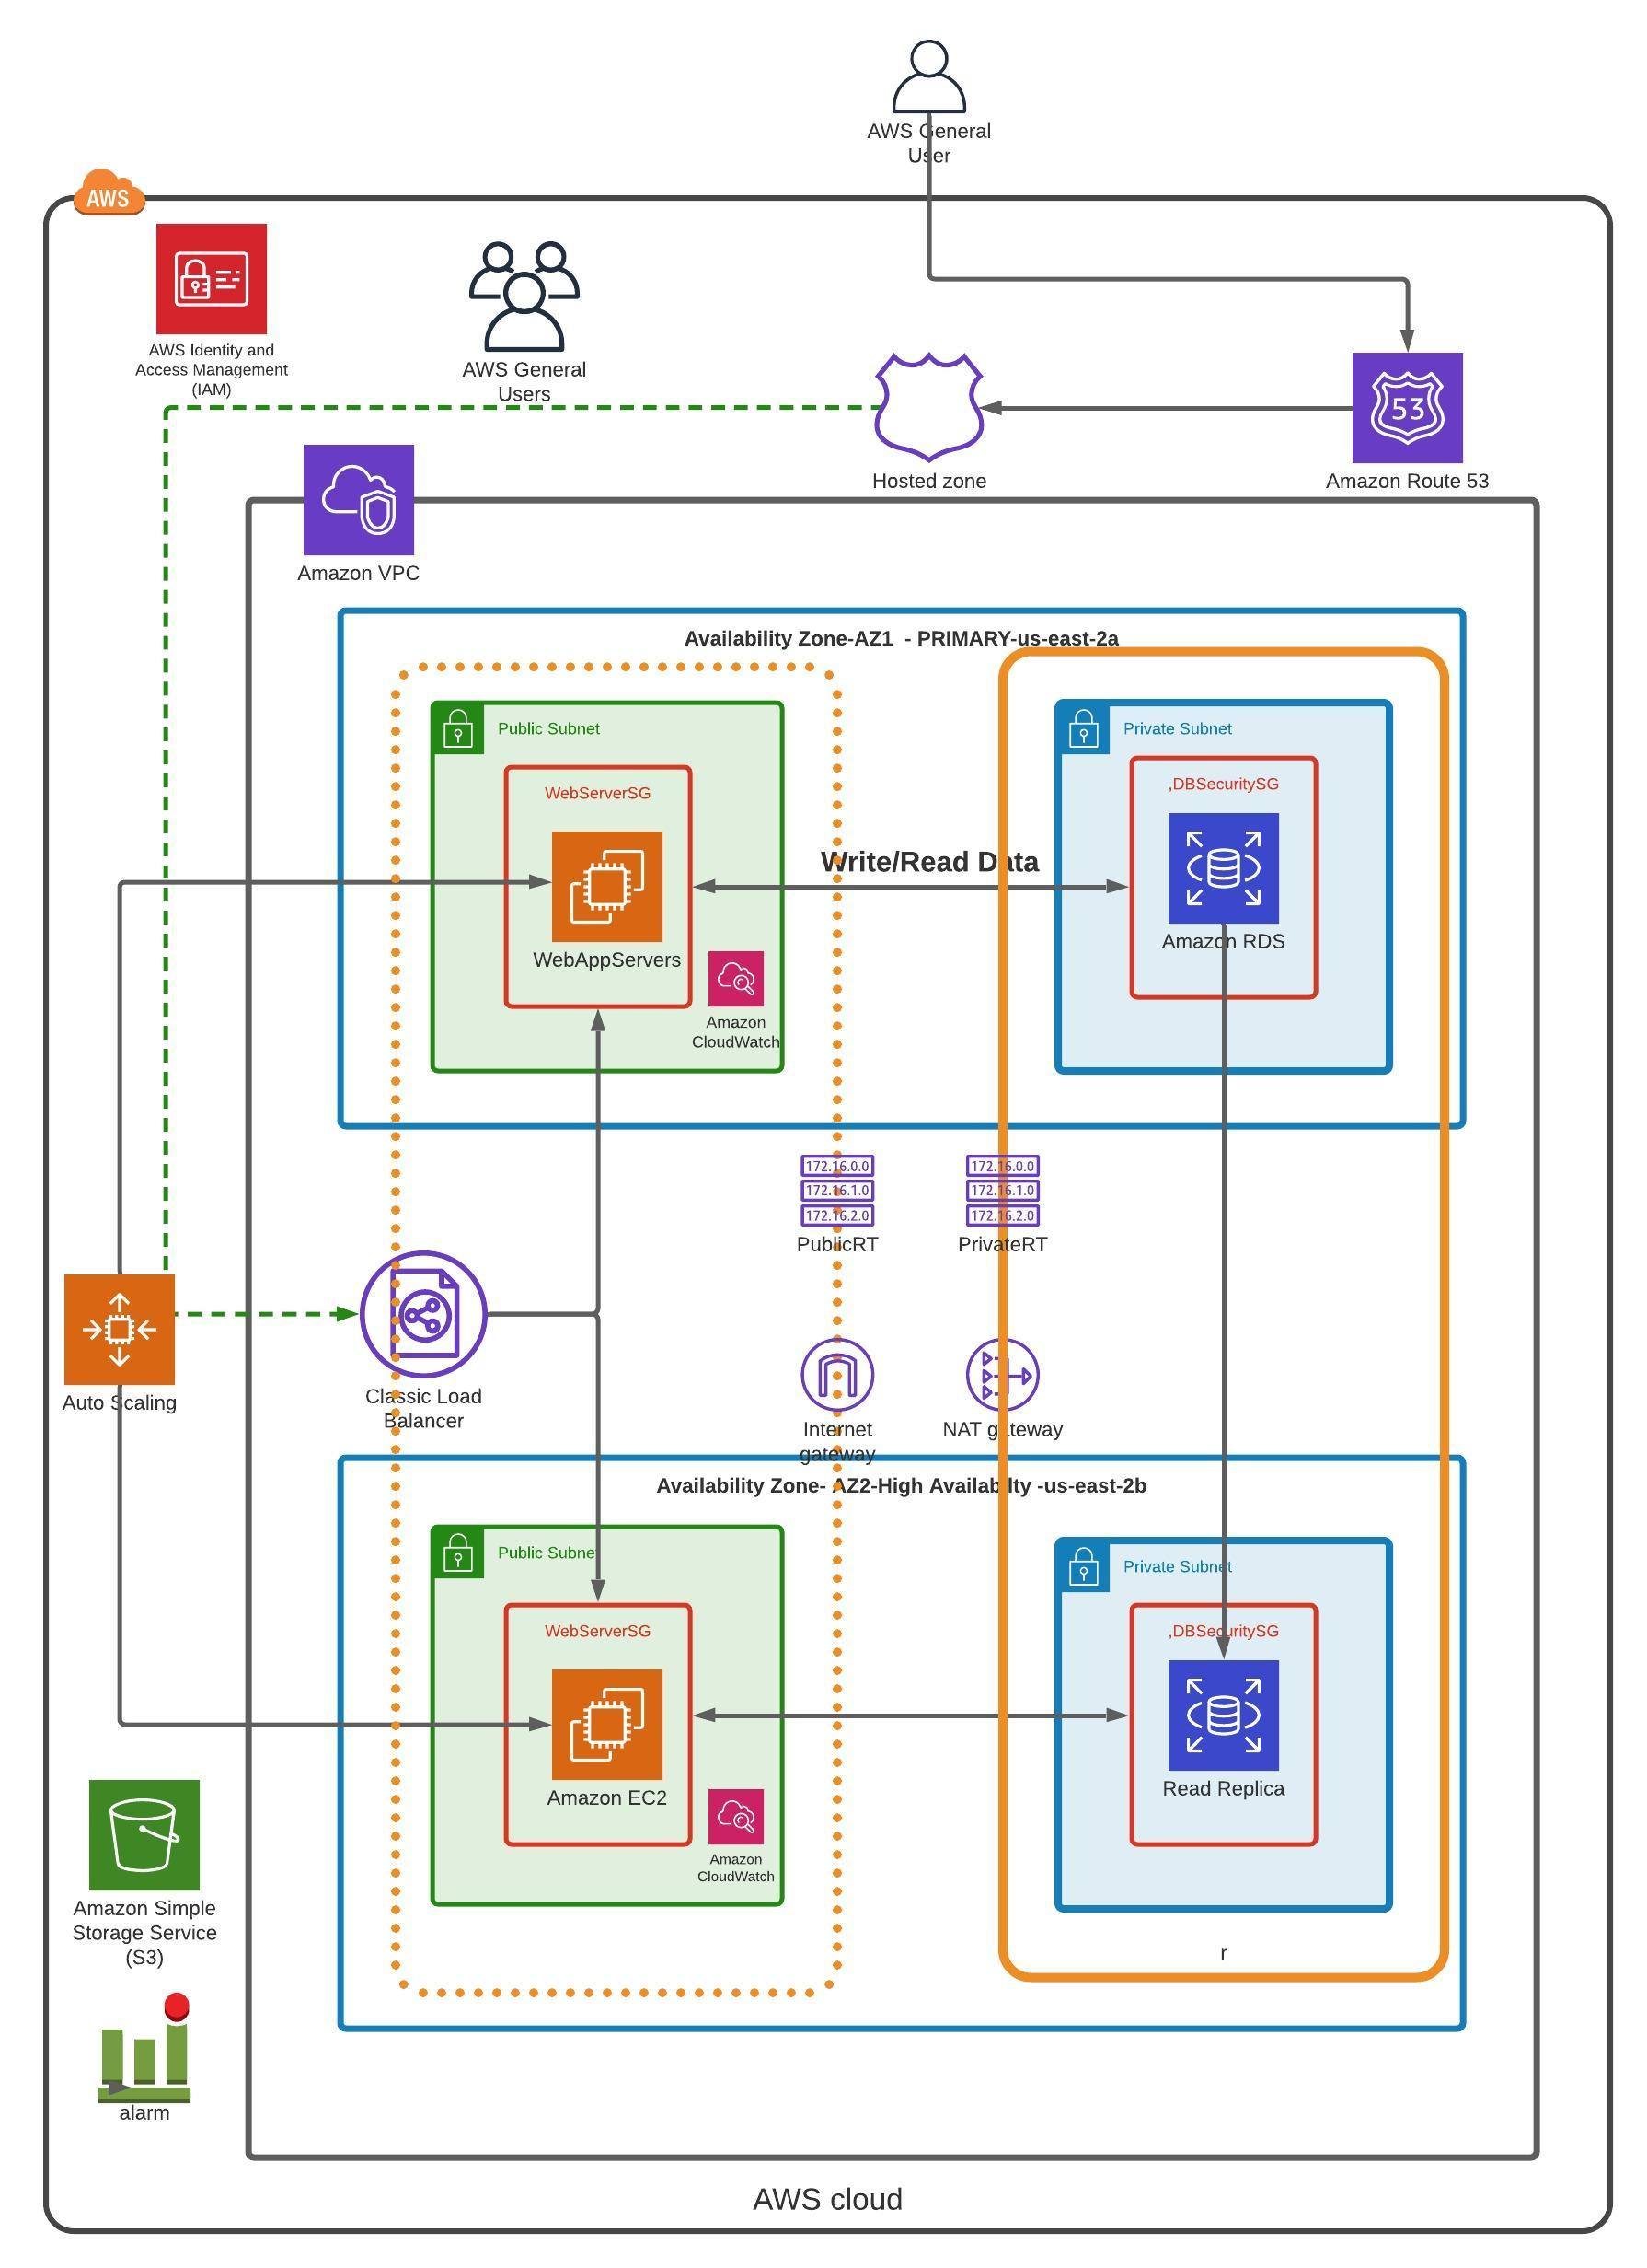
AWS INFRASTRUCTURE

Slide 5
Dev Environment
Developer
dev env
GITHUB/develop
git pull
git add
commit & push
dev-mvn-build-clean
dev-mvn-build-war
dev-warUploadtos3
dev-warUploadtos3
dev-warUploadtos3
dev-warDownloadtoS3
dev-packer-build-AMI
dev-packer-AMI
Ubuntu-AMI
dev-terraform-pr
dev-terraform-pr
dev-packer-AMI

Slide 6
QA Release
dev-terraform-pr
GITHUB/release
git pull
qa-mvn-build-clean
qa-mvn-build-war
qa-warUploadtos3
qa-warUploadtos3
qa-warUploadtos3
qa-warDownloadtoS3
qa-packer-build-AMI
qa-packer-AMI
Ubuntu-AMI
qa-terraform-pr
qa-terraform-pr
qa-packer-AMI

Slide 7
Production Release
qa-terraform-pr
GITHUB/main
git pull
prod-mvn-build-clean
prod-mvn-build-war
prod-warUploadtos3
prod-warUploadtos3
prod-warUploadtos3
prod-warDownloadtoS3
prod-packer-build-AMI
prod-packer-AMI
Ubuntu-AMI
prod-terraform-pr
prod-terraform-pr
prod-packer-AMI

